Slide 1


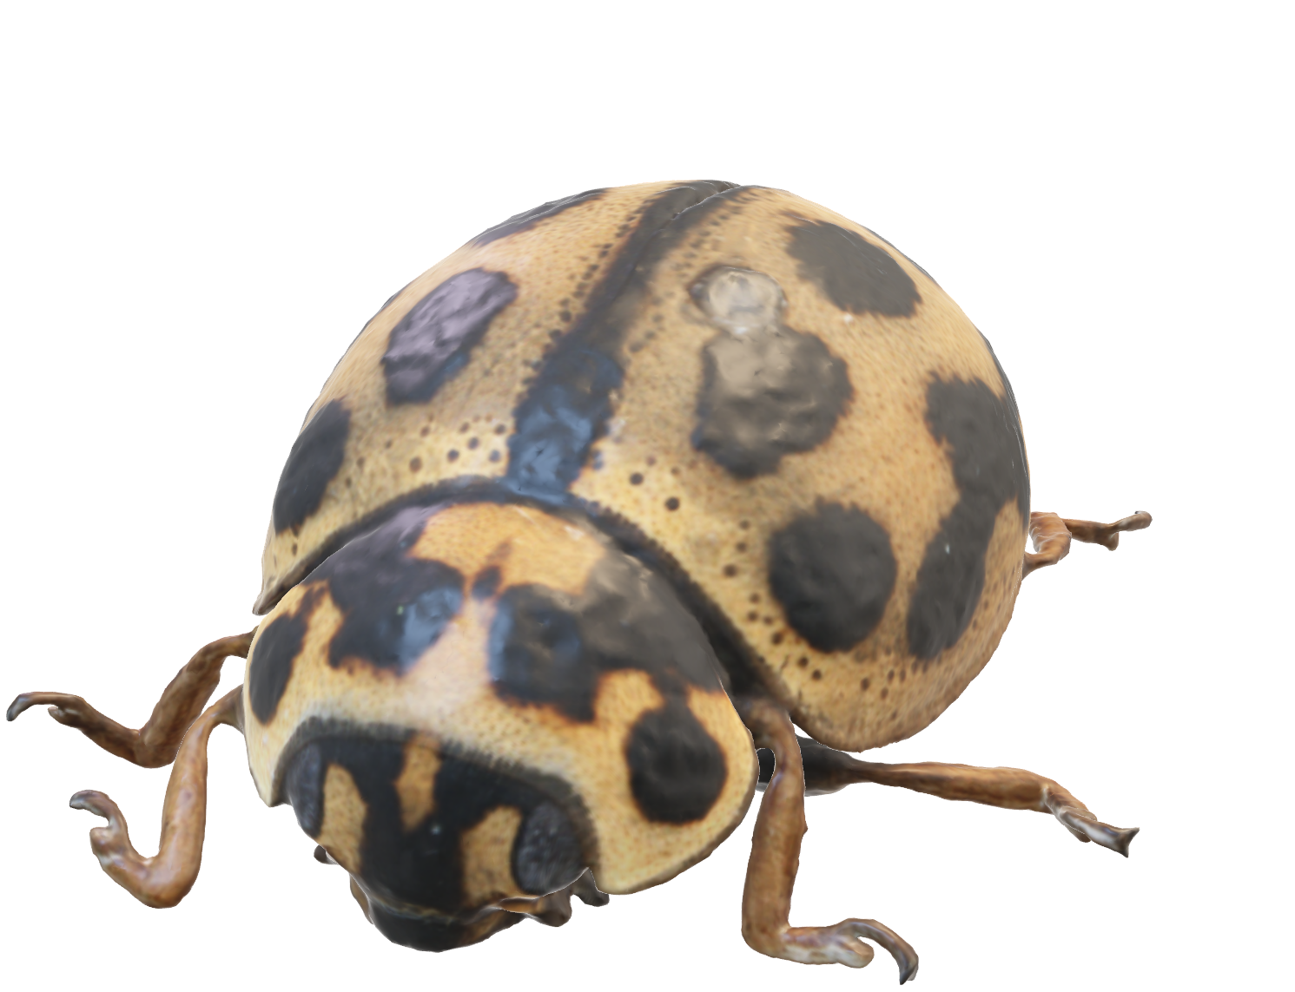
Diet
Defense
Ladybugs are beneficial insects for gardens and
When threatened, ladybugs can secrete a yellow, foul-tasting fluid from their joints
ladyBugs
Representing a diverse group of beetles, with over 5,000 known species worldwide.
Notes:
Diet: Ladybugs are beneficial insects for gardens and agriculture because they are voracious predators of aphids and other small insects that can be harmful to plants. A single ladybug can consume hundreds of aphids in a day.
Defensive Mechanism: When threatened, ladybugs can secrete a yellow, foul-tasting fluid from their joints, deterring predators.
Hibernation: Ladybugs often hibernate in large groups during the winter. They may seek shelter in natural or man-made structures, such as tree bark or buildings.
Longevity: The lifespan of a ladybug varies depending on species and environmental conditions. On average, they may live for several weeks to a few months.

Slide 2
Diet
Defense
Ladybugs are beneficial insects for gardens and
When threatened, ladybugs can secrete a yellow, foul-tasting fluid from their joints
Notes:
Diet: Ladybugs are beneficial insects for gardens and agriculture because they are voracious predators of aphids and other small insects that can be harmful to plants. A single ladybug can consume hundreds of aphids in a day.
Defensive Mechanism: When threatened, ladybugs can secrete a yellow, foul-tasting fluid from their joints, deterring predators.
Hibernation: Ladybugs often hibernate in large groups during the winter. They may seek shelter in natural or man-made structures, such as tree bark or buildings.
Longevity: The lifespan of a ladybug varies depending on species and environmental conditions. On average, they may live for several weeks to a few months.

Slide 3
Diet
Defense
Ladybugs are beneficial insects for gardens and
When threatened, ladybugs can secrete a yellow, foul-tasting fluid from their joints
Notes:
Diet: Ladybugs are beneficial insects for gardens and agriculture because they are voracious predators of aphids and other small insects that can be harmful to plants. A single ladybug can consume hundreds of aphids in a day.
Defensive Mechanism: When threatened, ladybugs can secrete a yellow, foul-tasting fluid from their joints, deterring predators.
Hibernation: Ladybugs often hibernate in large groups during the winter. They may seek shelter in natural or man-made structures, such as tree bark or buildings.
Longevity: The lifespan of a ladybug varies depending on species and environmental conditions. On average, they may live for several weeks to a few months.

Slide 4
Diet
Defense
Ladybugs are beneficial insects for gardens and
When threatened, ladybugs can secrete a yellow, foul-tasting fluid from their joints
Notes:
Diet: Ladybugs are beneficial insects for gardens and agriculture because they are voracious predators of aphids and other small insects that can be harmful to plants. A single ladybug can consume hundreds of aphids in a day.
Defensive Mechanism: When threatened, ladybugs can secrete a yellow, foul-tasting fluid from their joints, deterring predators.
Hibernation: Ladybugs often hibernate in large groups during the winter. They may seek shelter in natural or man-made structures, such as tree bark or buildings.
Longevity: The lifespan of a ladybug varies depending on species and environmental conditions. On average, they may live for several weeks to a few months.

Slide 5



Diet
Defense
Hibernation
Longevity
Ladybugs are beneficial insects for gardens and
When threatened, ladybugs can secrete a yellow, foul-tasting fluid from their joints
Ladybugs often hibernate in large groups during the winter
On average, they may live for several weeks to a few months.
ladyBugs
Representing a diverse group of beetles, with over 5,000 known species worldwide.
Notes:
Diet: Ladybugs are beneficial insects for gardens and agriculture because they are voracious predators of aphids and other small insects that can be harmful to plants. A single ladybug can consume hundreds of aphids in a day.
Defensive Mechanism: When threatened, ladybugs can secrete a yellow, foul-tasting fluid from their joints, deterring predators.
Hibernation: Ladybugs often hibernate in large groups during the winter. They may seek shelter in natural or man-made structures, such as tree bark or buildings.
Longevity: The lifespan of a ladybug varies depending on species and environmental conditions. On average, they may live for several weeks to a few months.

Slide 6
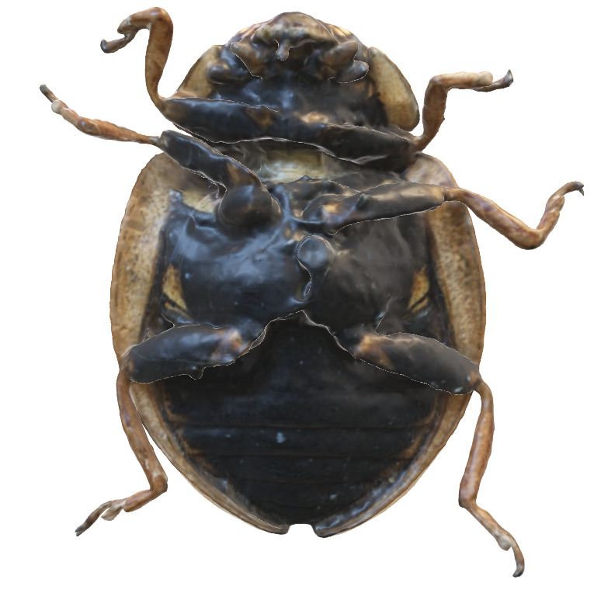
Diet
Defense
Hibernation
Longevity
Ladybugs are beneficial insects for gardens and
When threatened, ladybugs can secrete a yellow, foul-tasting fluid from their joints
Ladybugs often hibernate in large groups during the winter
On average, they may live for several weeks to a few months.
Notes:
Diet: Ladybugs are beneficial insects for gardens and agriculture because they are voracious predators of aphids and other small insects that can be harmful to plants. A single ladybug can consume hundreds of aphids in a day.
Defensive Mechanism: When threatened, ladybugs can secrete a yellow, foul-tasting fluid from their joints, deterring predators.
Hibernation: Ladybugs often hibernate in large groups during the winter. They may seek shelter in natural or man-made structures, such as tree bark or buildings.
Longevity: The lifespan of a ladybug varies depending on species and environmental conditions. On average, they may live for several weeks to a few months.

Slide 7
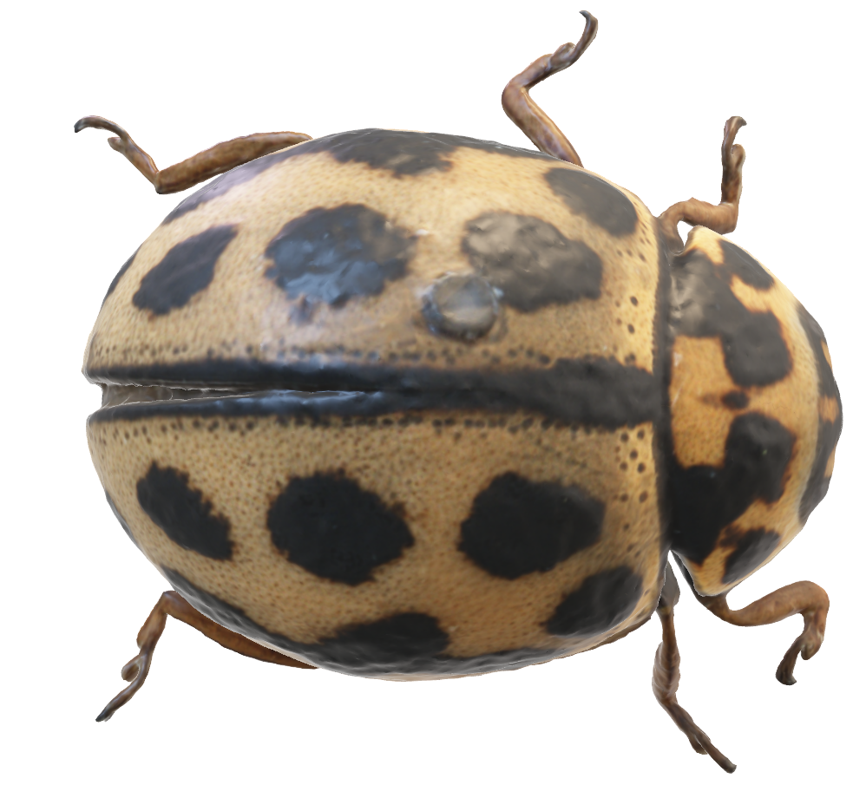
Diet
Defense
Hibernation
Longevity
Ladybugs are beneficial insects for gardens and
When threatened, ladybugs can secrete a yellow, foul-tasting fluid from their joints
Ladybugs often hibernate in large groups during the winter
On average, they may live for several weeks to a few months.
Notes:
Diet: Ladybugs are beneficial insects for gardens and agriculture because they are voracious predators of aphids and other small insects that can be harmful to plants. A single ladybug can consume hundreds of aphids in a day.
Defensive Mechanism: When threatened, ladybugs can secrete a yellow, foul-tasting fluid from their joints, deterring predators.
Hibernation: Ladybugs often hibernate in large groups during the winter. They may seek shelter in natural or man-made structures, such as tree bark or buildings.
Longevity: The lifespan of a ladybug varies depending on species and environmental conditions. On average, they may live for several weeks to a few months.

Slide 8
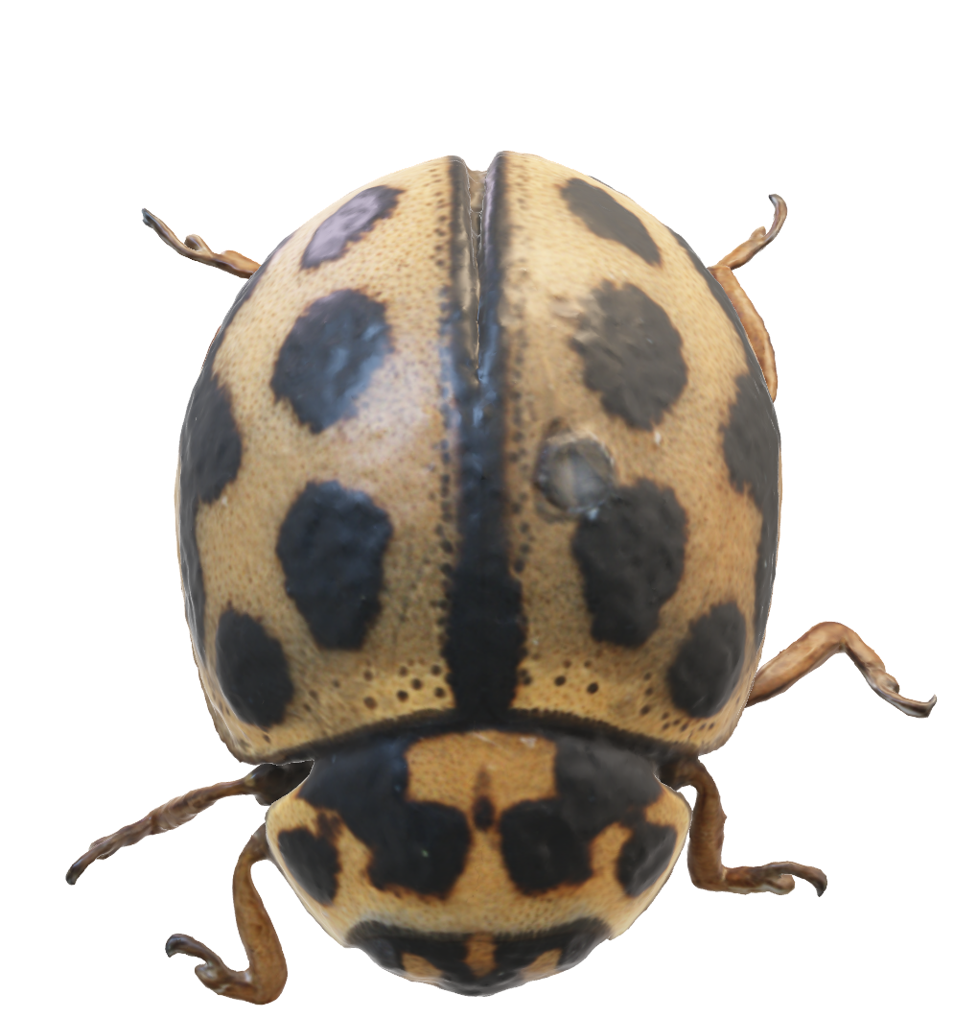
Diet
Defense
Hibernation
Longevity
Ladybugs are beneficial insects for gardens and
When threatened, ladybugs can secrete a yellow, foul-tasting fluid from their joints
Ladybugs often hibernate in large groups during the winter
On average, they may live for several weeks to a few months.
Notes:
Diet: Ladybugs are beneficial insects for gardens and agriculture because they are voracious predators of aphids and other small insects that can be harmful to plants. A single ladybug can consume hundreds of aphids in a day.
Defensive Mechanism: When threatened, ladybugs can secrete a yellow, foul-tasting fluid from their joints, deterring predators.
Hibernation: Ladybugs often hibernate in large groups during the winter. They may seek shelter in natural or man-made structures, such as tree bark or buildings.
Longevity: The lifespan of a ladybug varies depending on species and environmental conditions. On average, they may live for several weeks to a few months.

Slide 9
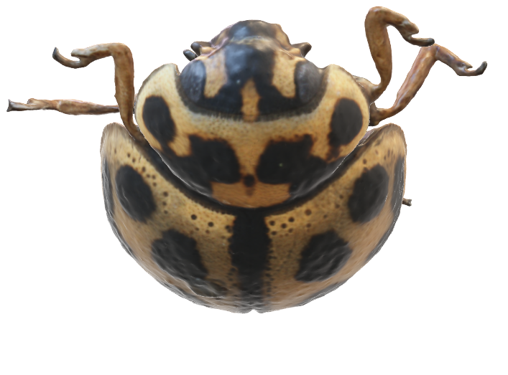
Diet
Defense
Hibernation
Longevity
Ladybugs are beneficial insects for gardens and
When threatened, ladybugs can secrete a yellow, foul-tasting fluid from their joints
Ladybugs often hibernate in large groups during the winter
On average, they may live for several weeks to a few months.
Notes:
Diet: Ladybugs are beneficial insects for gardens and agriculture because they are voracious predators of aphids and other small insects that can be harmful to plants. A single ladybug can consume hundreds of aphids in a day.
Defensive Mechanism: When threatened, ladybugs can secrete a yellow, foul-tasting fluid from their joints, deterring predators.
Hibernation: Ladybugs often hibernate in large groups during the winter. They may seek shelter in natural or man-made structures, such as tree bark or buildings.
Longevity: The lifespan of a ladybug varies depending on species and environmental conditions. On average, they may live for several weeks to a few months.

Slide 10

Diet
Defense
Hibernation
Longevity
A REMARKABLE FELLA
Ladybugs are beneficial insects for gardens and
When threatened, ladybugs can secrete a yellow, foul-tasting fluid from their joints
Ladybugs often hibernate in large groups during the winter
On average, they may live for several weeks to a few months.
Notes:
Diet: Ladybugs are beneficial insects for gardens and agriculture because they are voracious predators of aphids and other small insects that can be harmful to plants. A single ladybug can consume hundreds of aphids in a day.
Defensive Mechanism: When threatened, ladybugs can secrete a yellow, foul-tasting fluid from their joints, deterring predators.
Hibernation: Ladybugs often hibernate in large groups during the winter. They may seek shelter in natural or man-made structures, such as tree bark or buildings.
Longevity: The lifespan of a ladybug varies depending on species and environmental conditions. On average, they may live for several weeks to a few months.

Slide 11
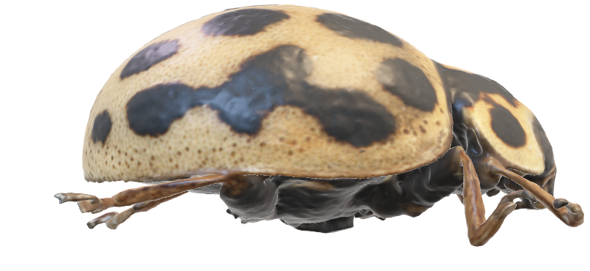
I found this nice GLB model here:
https://sketchfab.com/3d-models/tytthaspis-sedecimpunctata-b14201002b5e4a22957819204be935d0

